Slide 1
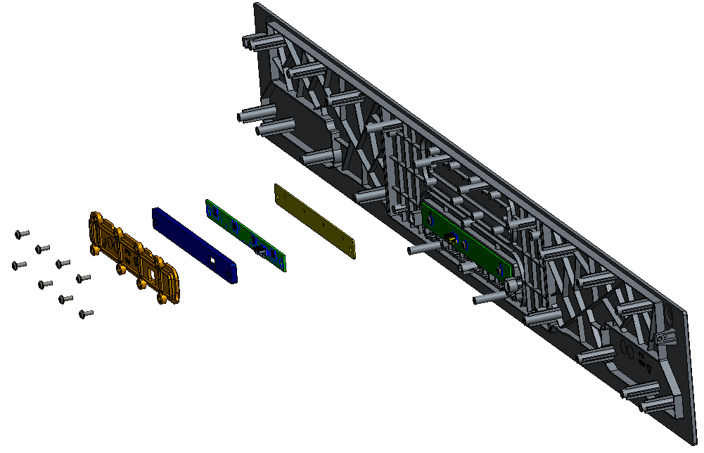
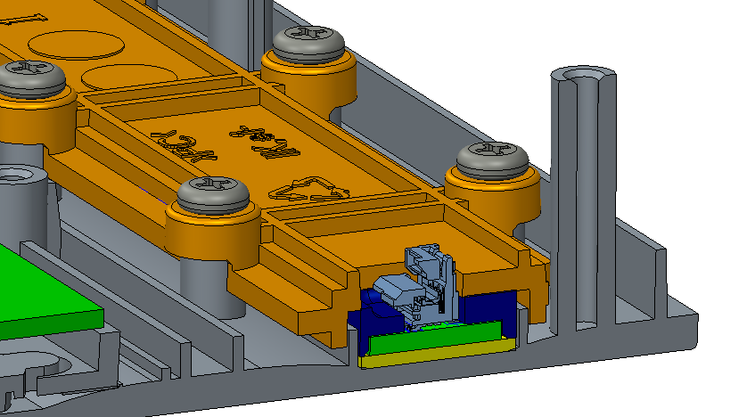
MIC board assembly
Top Cover
Holder MIC
MIC Board
Screw M3_7mm x8
Silicon MIC
Sponge MIC Silicon

Slide 2
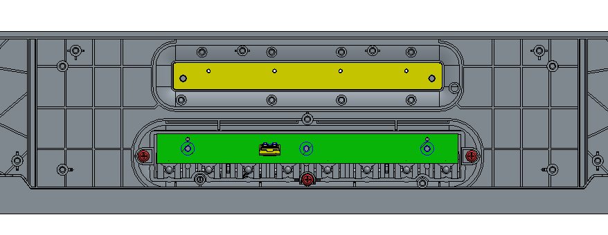
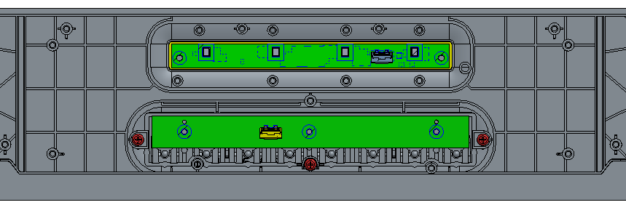
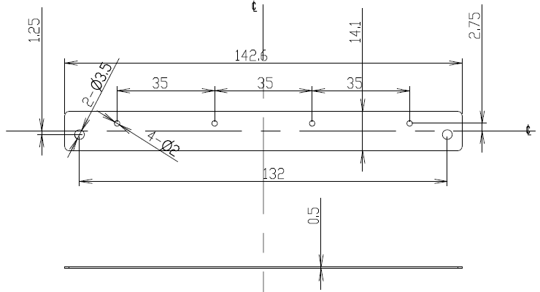
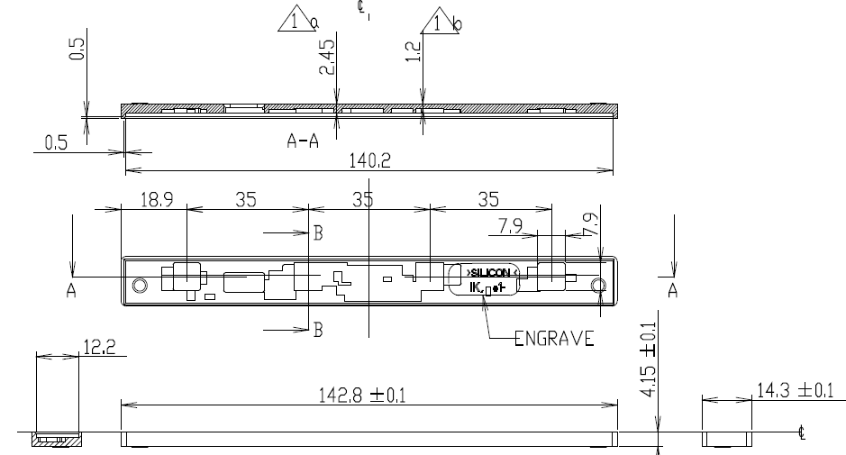
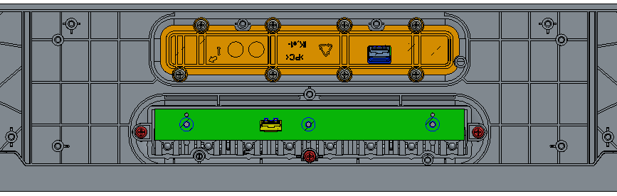
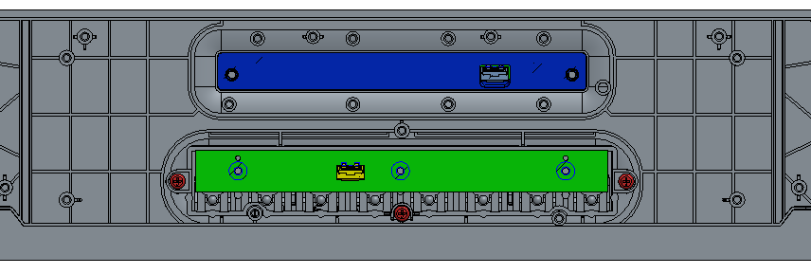
The MIC test is failed base on the DVT MIC sealing, and the test is pass after filling the MIC component for isolation(please check the test report). So we suggest to modify the SPONGE_MIC_SILICON and SILICON_MIC for mic sealing issues.

Slide 3
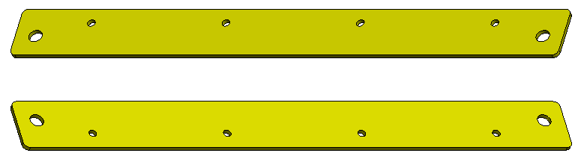
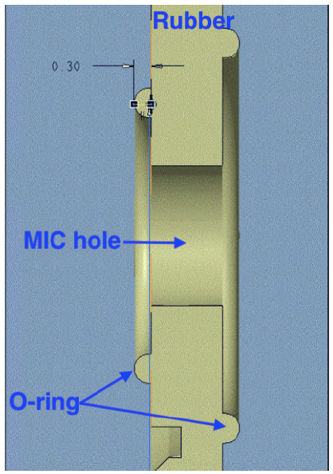
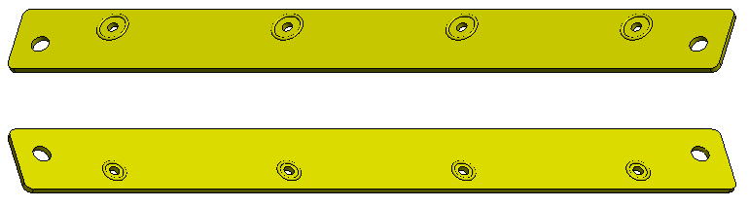
SPONGE_MIC_SILICON
Current
Modified
Add O-Ring to top and bottom side on the MIC hole of SPONGE_MIC_SILICON

Slide 4
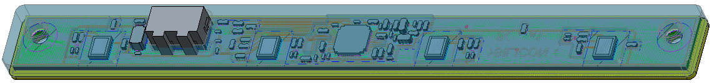
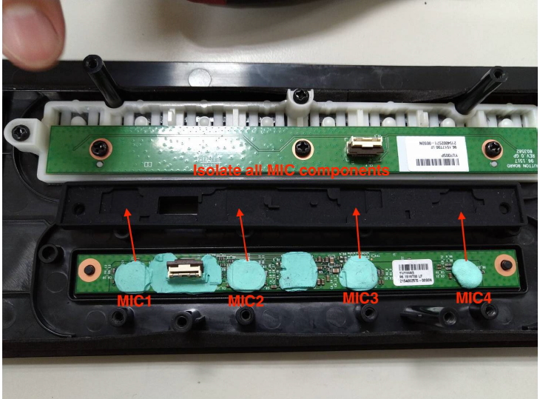
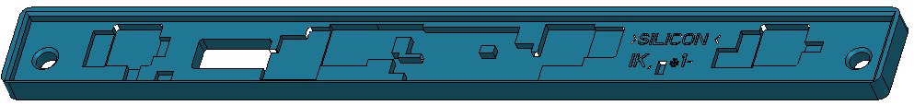
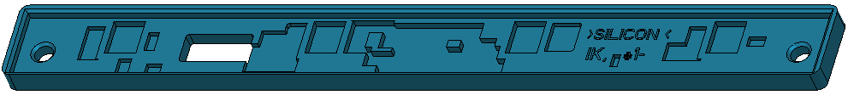
SILICON_MIC
Current
Modified
Isolate MIC for sealing solution

